Slide 1

6th Grade
Unit 8, Lesson 12 Finding Surface Area and Volume Volume 2, pg. 135

Slide 2


Benchmarks
MA.6.GR.2.4
Given a mathematical or real-world context, find the surface area of right rectangular prisms and right rectangular pyramids using the figure’s net.
MA.6.GR.2.3
Solve mathematical and real-world problems involving the volume of right rectangular prisms with positive rational number edge lengths using a visual model and a formula.
volume 2, pg. 135

Slide 3
Integrated Mathematical Thinking and Reasoning Standards
MA.K12.MTR.1.1 Actively participate in effortful learning both individually and collectively.
MA.K12.MTR.2.1 Demonstrate understanding by representing problems in multiple ways.
MA.K12.MTR.4.1 Engage in discussions that reflect on the mathematical thinking of self and others.
MA.K12.MTR.5.1 Use patterns and structure to help understand and connect mathematical concepts.
MA.K12.MTR.7.1 Apply mathematics to real-world contexts.
volume 2, pg. 135

Slide 4

Learning Targets
I can find the surface area of right rectangular prisms and right rectangular pyramids.
I can find the volume of right rectangular prisms.
volume 2, pg. 135

Slide 5

Warm-Up
volume 2, pg. 136

Slide 6



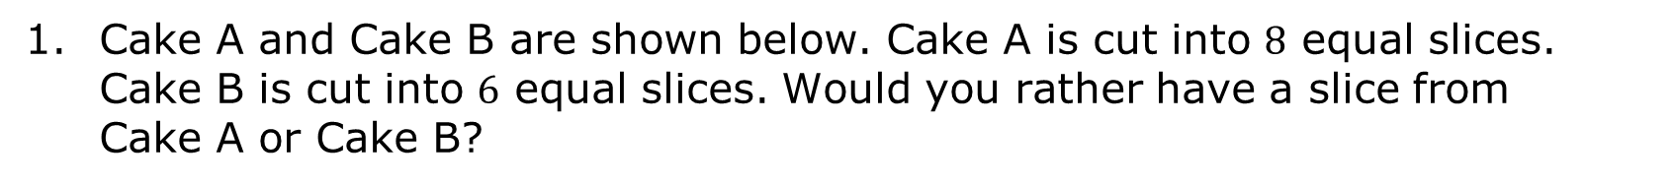

8.12.1 Warm-Up: Would You Rather?
Cake A and Cake B are shown below. Cake A is cut into $8$ equal slices. Cake B is cut into $6$ equal slices. Would you rather have a slice from Cake A or Cake B?
Cake A
Cake B
!
Happy Birthday!
Happy Birthday!
$$12"$$
$$15"$$
$$17"$$
$$15"$$
volume 2, pg. 136

Slide 7

Collaboration
volume 2, pg. 136

Slide 8

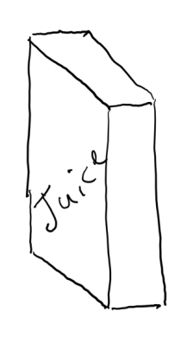



8.12.2 Collaboration: Which Juice Box is Better?
Julius is designing a juice box. He drew a model of his box.
If the juice box has a volume of $196.875$ cubic centimeters (cm³), what is the width of the box?
$10.5$ cm
$5$ cm
?
volume 2, pg. 136

Slide 9
How much packaging board would Julius need to make a juice box with these dimensions, not taking into consideration any overlap of the faces?
volume 2, pg. 137

Slide 10
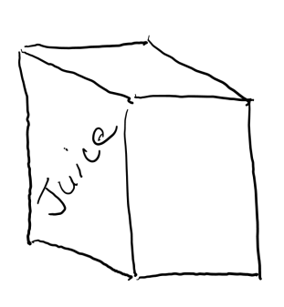


Julius wondered how the juice box would be affected if he changed the dimensions, but kept the volume the same.
What is the new length?
How much packaging board would Julius need to make the new juice box?
$7.5$ cm
?
$5$ cm
volume 2, pg. 137

Slide 11
If Julius wants to use the least amount of material to construct the juice box, which juice box should he choose? Explain your reasoning.
volume 2, pg. 138

Slide 12

Guided Practice
volume 2, pg. 138

Slide 13

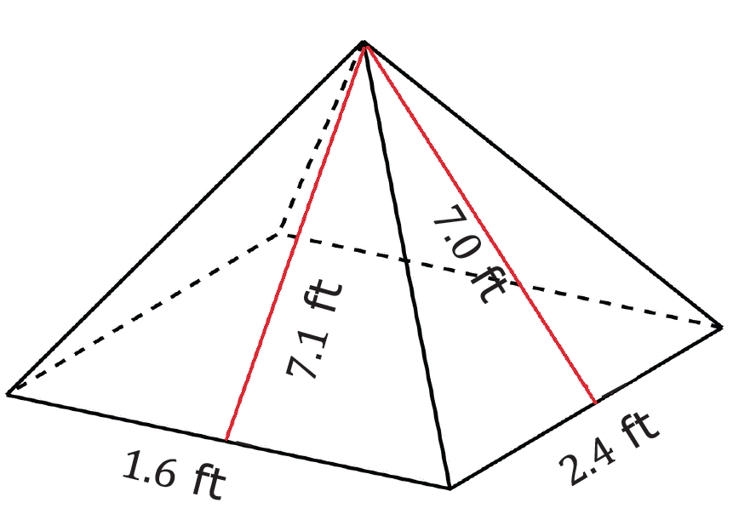
8.12.3 Guided Practice: Surface Area and Volume
With your partner, complete the chart for the three-dimensional figures below.
volume 2, pg. 138

Slide 14
What is the type of figure?
Draw a net or the individual faces of the figure. Label the measurements.
Find the surface area of the figure.
volume 2, pg. 138

Slide 15
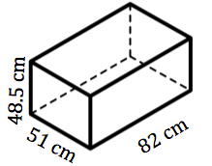
volume 2, pg. 139

Slide 16
What is the type of figure?
Draw a net or the individual faces of the figure. Label the measurements.
Find the surface area of the figure.
Find the volume of the figure.
volume 2, pg. 139

Slide 17

Your Turn
volume 2, pg. 139

Slide 18
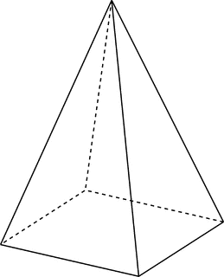
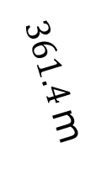
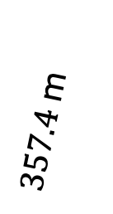
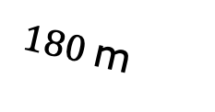
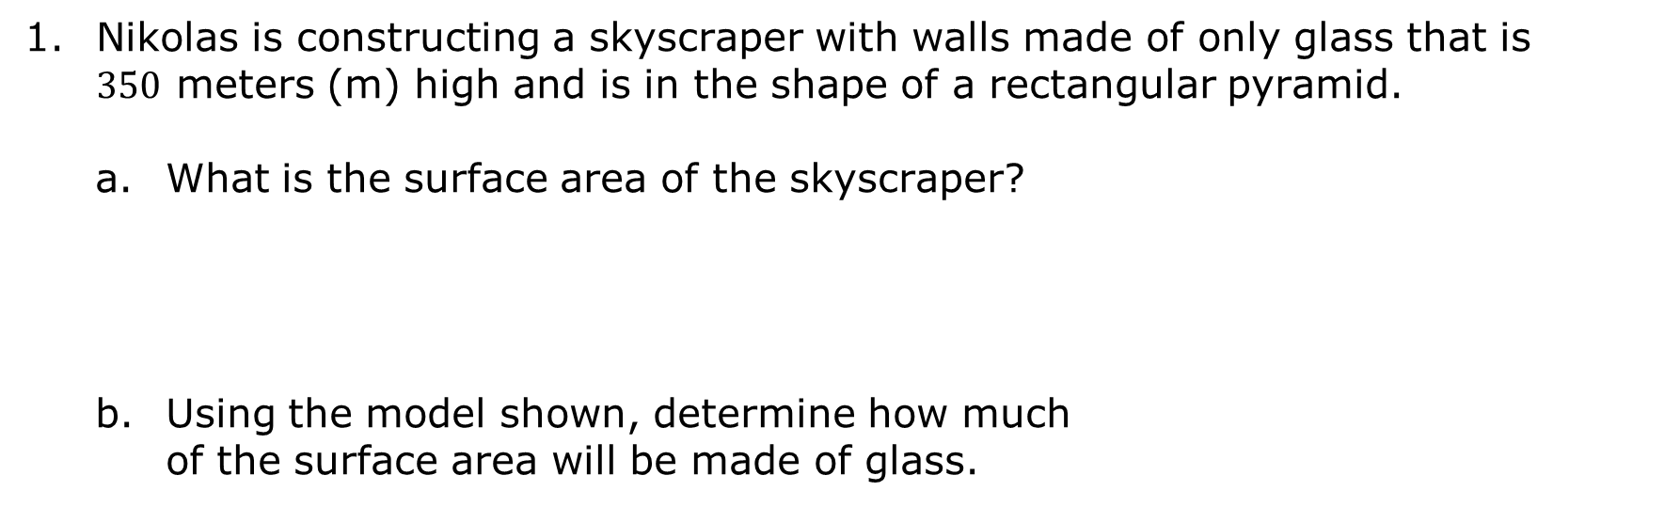
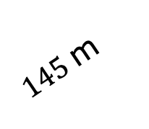
8.12.4 Your Turn!
Nikolas is constructing a skyscraper with walls made of only glass that is $350$ meters (m) high and is in the shape of a rectangular pyramid.
What is the surface area of the skyscraper?
Using the model shown, determine how much of the surface area will be made of glass.
$357.4$m
$361.4$m
$145$m
$180$m
volume 2, pg. 139

Slide 19
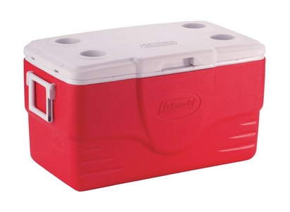




A cooler has a length of $78$ centimeters (cm), a height of $74$ cm, and a width of $40$ cm.
Find the surface area of the cooler.
Find the volume of the cooler.
$74$cm
$40$cm
$78$cm
volume 2, pg. 140

Slide 20
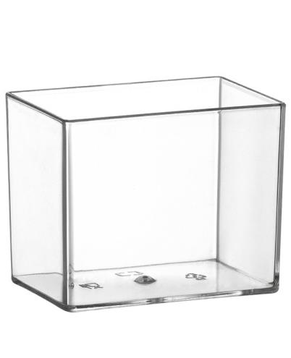
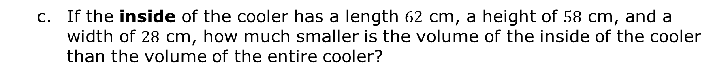



If the inside of the cooler has a length $62$ cm, a height of $58$ cm, and a width of $28$ cm, how much smaller is the volume of the inside of the cooler than the volume of the entire cooler?
$58$cm
$28$cm
$62$cm
volume 2, pg. 140

Slide 21
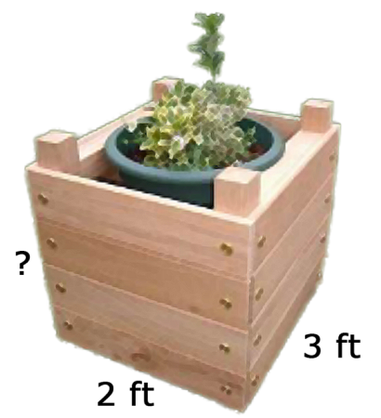

Tamya is creating a gardening box that needs to have a volume of $13.5 {\text{ft}}^{3}$.
If the box has a width of 3 feet and a length of $2$ feet, what is the height?
Tamya decided to paint the exterior walls of the gardening box and needs to know how much paint to buy. What is the surface area of the area she wants to paint?
volume 2, pg. 140

Slide 22
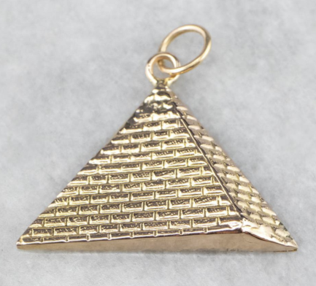



Ryan makes custom jewelry and recently received an order for a pendant in the shape of a rectangular pyramid. Ryan designed a hollow gold pendant to have a square base with a side length of $15$ millimeters (mm) and a slant height of $13.24$ mm.
How much gold does Ryan need to make the pendant?
$13.24$mm
$15$mm
volume 2, pg. 141

Slide 23

Wrap-Up
volume 2, pg. 141

Slide 24
8.12.5 Wrap-Up: Reflection
Rate yourself on each of the concepts.
4 – I can do this on my own.
3 – I can do this but need more practice.
2 – I need help getting started.
1 – I do not understand yet.
Concept | Rating
I can find the surface area of a right rectangular pyramid using a net or the figure. | 1 2 3 4
I can find the surface area of a right rectangular prism using a net or the figure. | 1 2 3 4
I can find the volume of a right rectangular prism. | 1 2 3 4
volume 2, pg. 141

Slide 25
A barrier to my learning today was …
I will try to overcome this by …
volume 2, pg. 141

